Slide 1



NIRAKULA TECHNOLGIES PVT.LTD
PRESENTS
FAS(Family Adoption By Students) Programme

Slide 2
PROBLEM STATEMENT
Medical and health-science students are expected to gain practical exposure to community health, family medicine, and socio-economic determinants of health. However, the current execution of the Family Adoption by Students Programme faces multiple challenges:
Manual and paper-based tracking of adopted families
Difficulty in maintaining long-term, structured family health records
Inconsistent data collection across students and visits
Lack of real-time visibility for faculty and administrators
Poor monitoring of student participation, visit frequency, and outcomes
Fragmented documentation of health issues, follow-ups, and interventions
Time-consuming report preparation for assessments and audits
Due to these limitations, the programme often becomes administratively heavy, poorly monitored, and less impactful, reducing both student learning outcomes and community health benefits.

Slide 3


SOLUTION
FAS provides a centralized, digital platform that streamlines and strengthens the Family Adoption by Students Programme by connecting students, families, and faculty on a single system.
🔧 What FAS Does
Digitally registers and maps adopted families to assigned students
Maintains structured, longitudinal family health records
Enables students to log house visits, observations, and interventions in real time
Ensures uniform data collection through predefined forms and workflows
Provides faculty with live dashboards to monitor student activity and progress
Automates reports, summaries, and documentation for assessments and audits
Stores data securely for continuity of care and academic reference

Slide 4

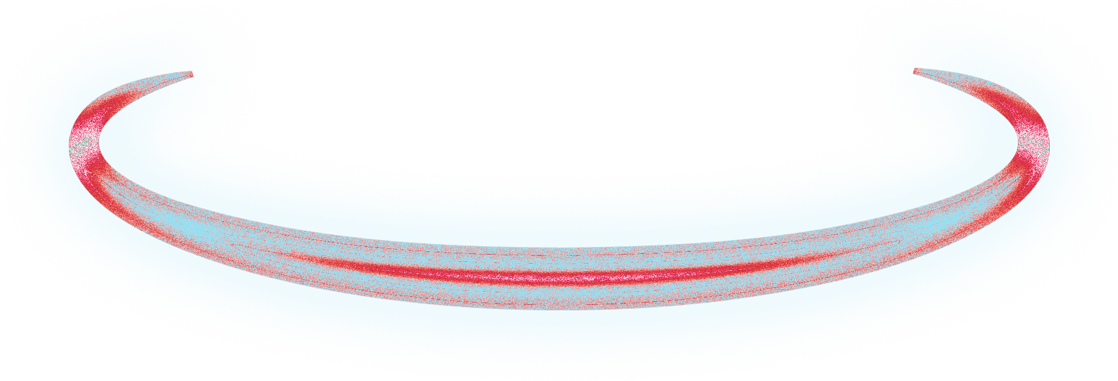
FEATURES

Slide 5
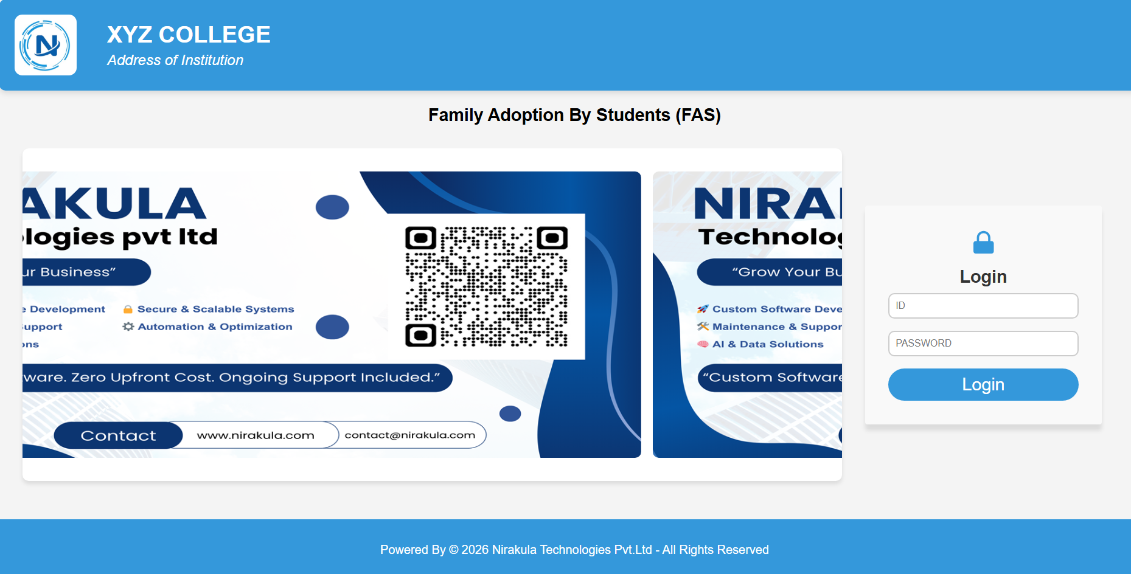
1 . LOGIN PAGE
Experience seamless access with our single-login system, designed to serve multiple types of users efficiently. Whether you're a student, faculty, or administrative staff, log in securely to access personalized dashboards and features.

Slide 6
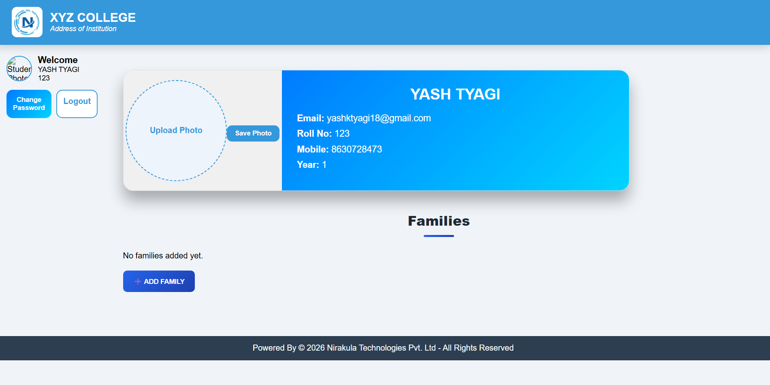
2 . STUDENT LOGIN :
-> Student card where details can be shown , also student can choose their photo to be shown on website page , below families section where registered families are shown

Slide 7
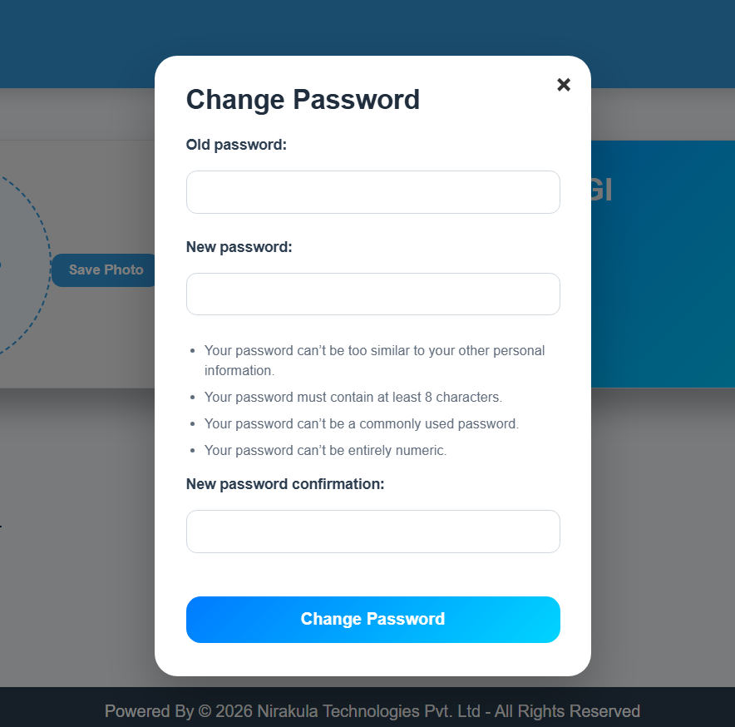
-> changing password facility so that they can secure their page .

Slide 8
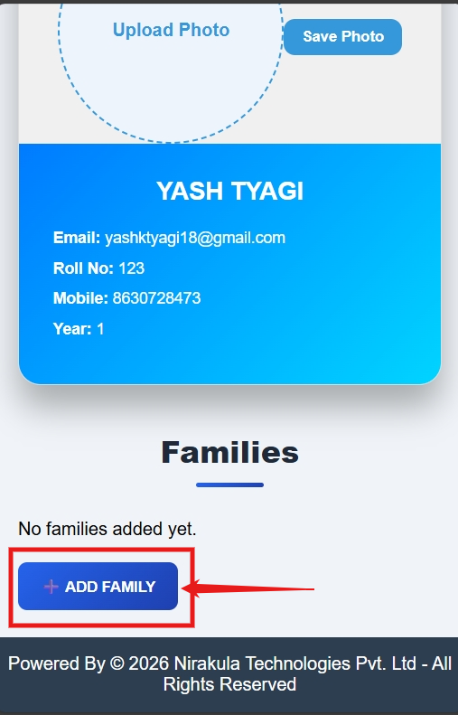
Registering Family
1 . Click on the button “ADD FAMILY“ for registering new family .

Slide 9
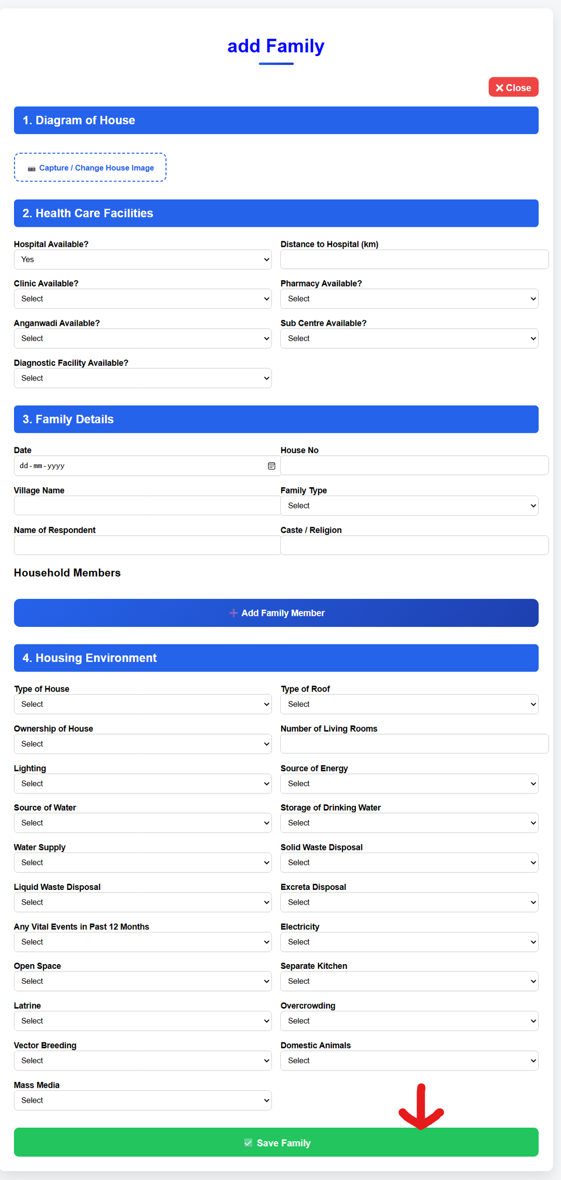
Registering Family
2 . An form will be open like image shown .
Their will be all fields required to be entered in Log Book .
Capturing House image using camera
Health care facilities available for family
family details with members
Housing Environment
Their are options to select as provided in log book to capture response fastly .
Students can easily register family without getting proper response for particular fields at that time and later edit it .

Slide 10
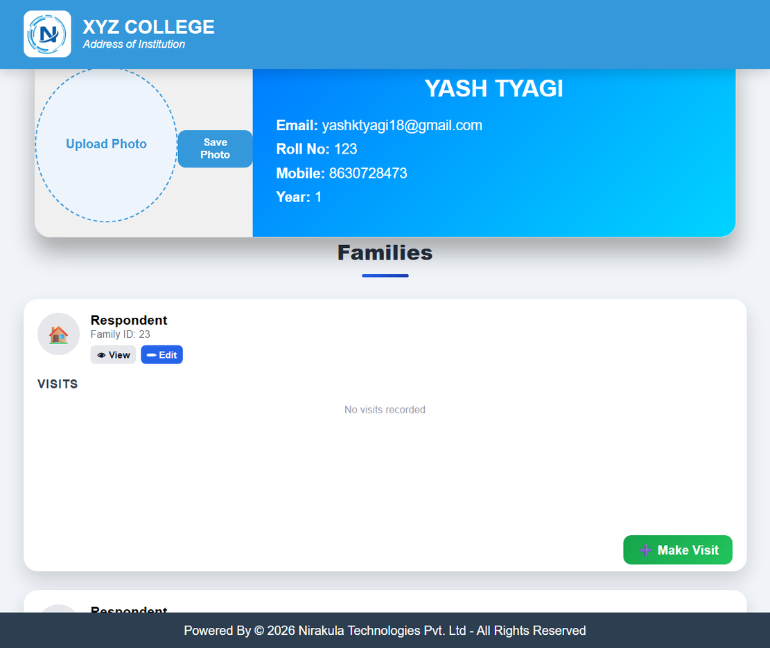
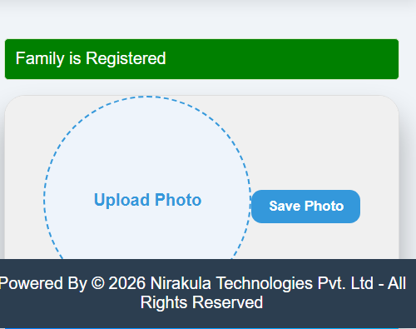
Registering Family
3 . “Family is registered “ message is shown on screen after successfull register .
In same page below family section that registered family card will be visible

Slide 11
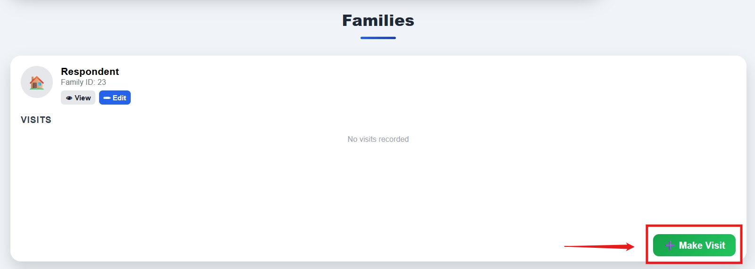
Visiting Family
1 . In Family section and in each card their is a button “Make Visit” to register a visit in that family and above that each visits of that family is shown .
click that button to record visit details

Slide 12
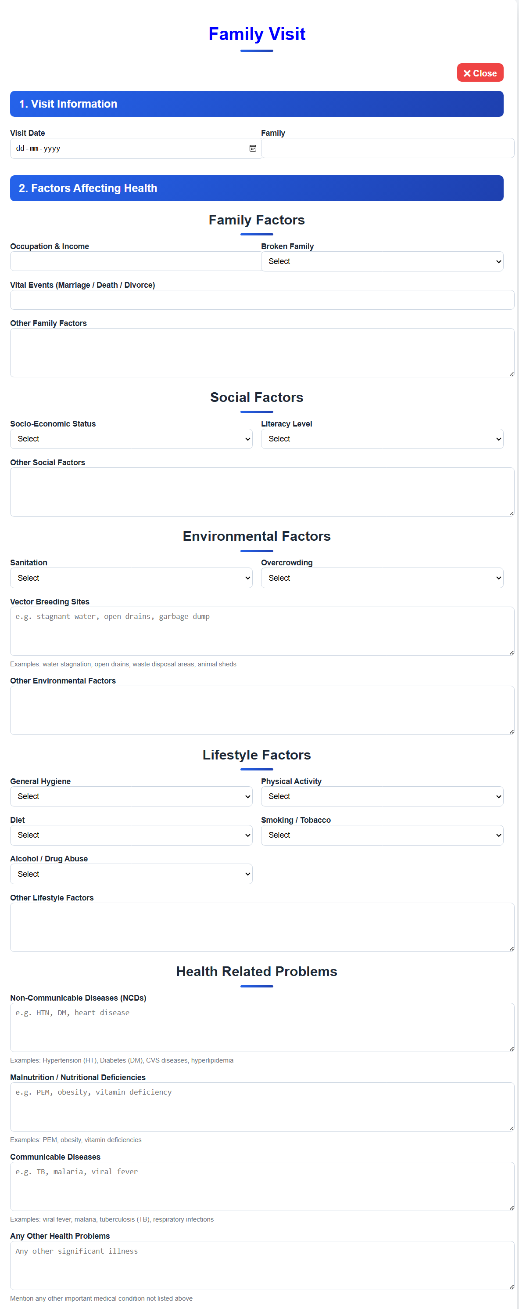
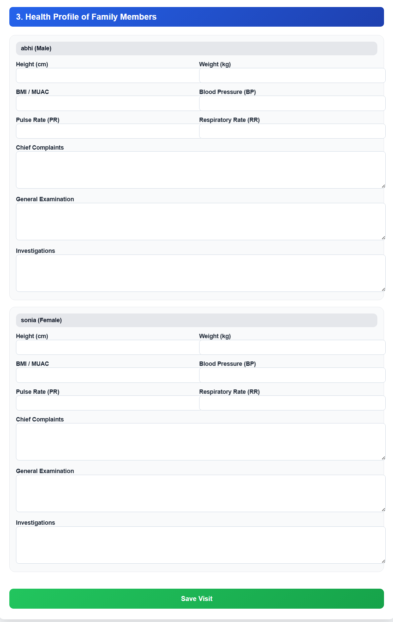
Visiting Family
2 .While visiting their are 3 sections
Visit details
factors affecting health
family members health record
In family members their is a specific feature that the members registered while family is registering those members cards will be shown student can not add member at visit , yes they can edit the deatils of family and then record visit details of family members

Slide 13
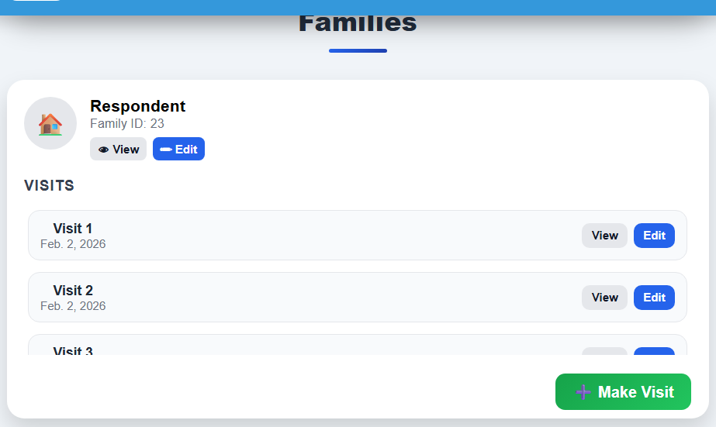
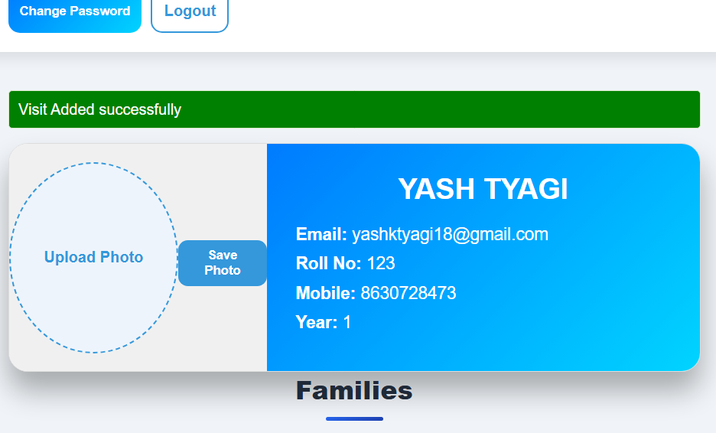
Visiting Family
3 . “Visit added successfully “ message is shown on screen after successfull visit .
In same page below family section that visit is shown in family card

Slide 14
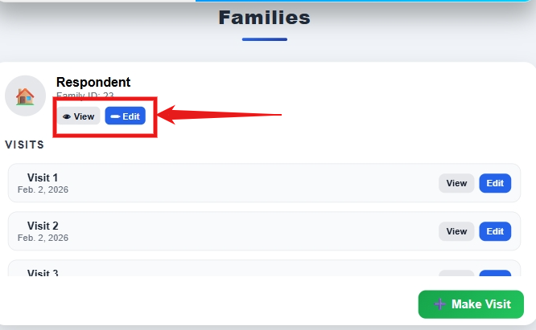
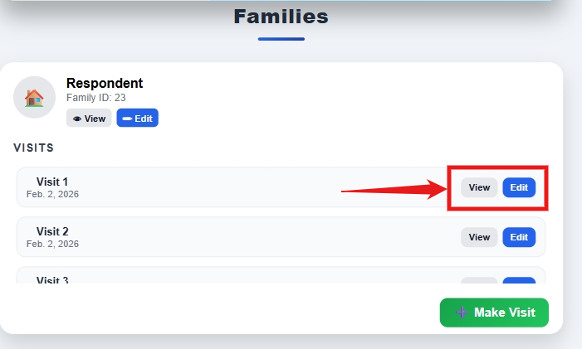
EDIT/VIEW OF FAMILY/VISITS
View and Edit buttons are indicated in the images both are present in their cards for family and as well as their each visits .
In view details can be viewed only no edits
in Edits details can be edited and update it easily

Slide 15
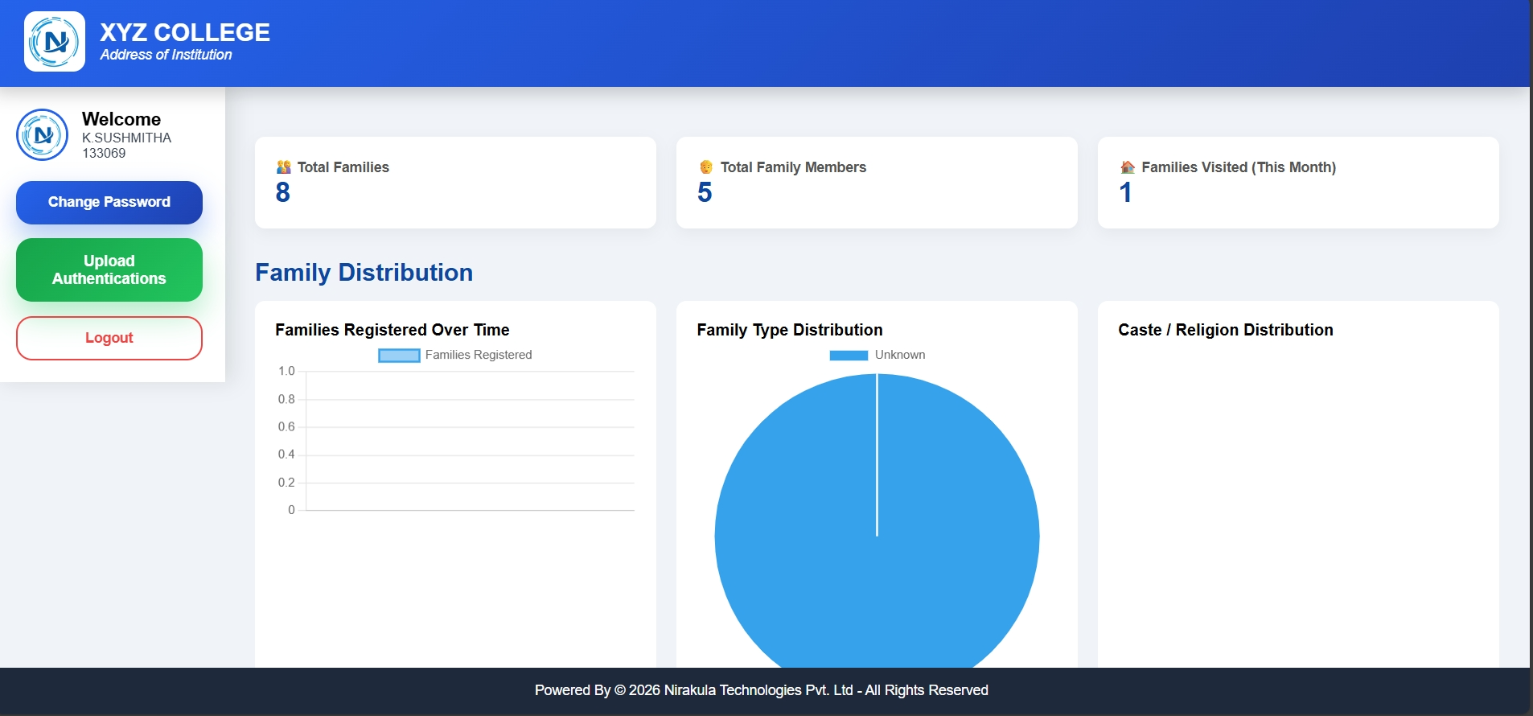
3 . ADMIN LOGIN :
Admin can evaluate the data recorded by students using graphs , tables and numbers
one more power that admin has is creating Authentications for students as well as more admins

Slide 16
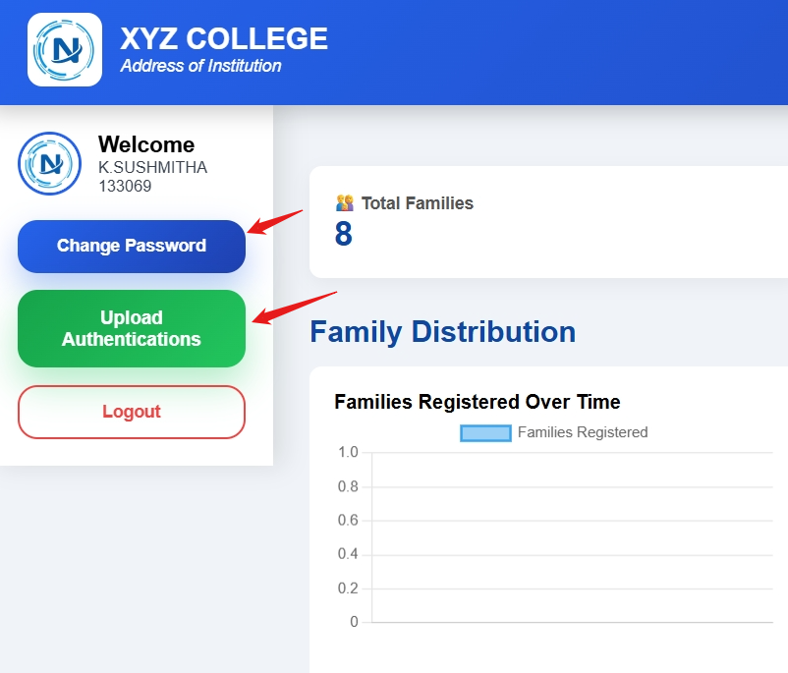
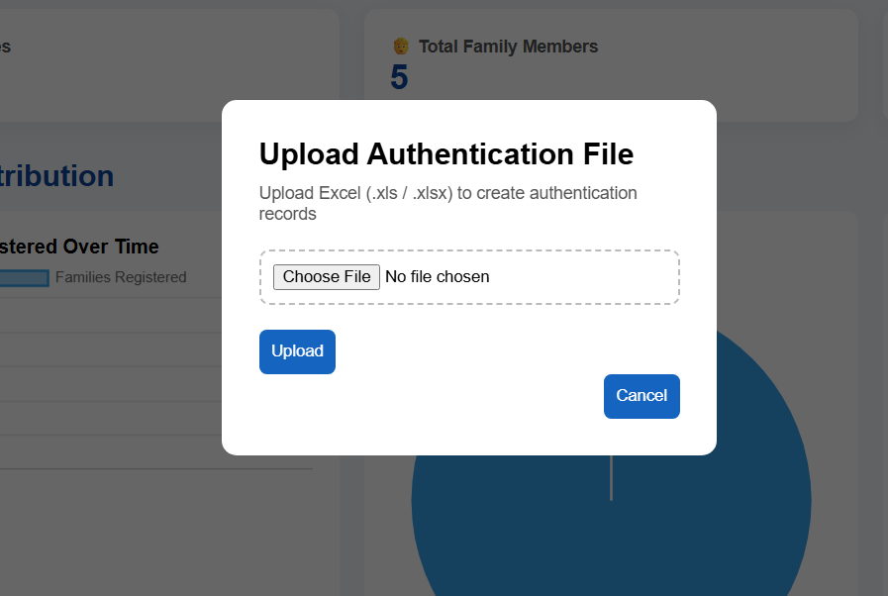

Slide 17
THAT’S ALL , YES IT’S FULLY CUSTOMIZABLE FROM USER INTERFACE TILL FEATURES .

Slide 18


CONTACT US
founder@nirakula.com
www.nirakula.com

Slide 19
THANK YOU

